Slide 1
FoodieSquad
Web Design Final Project
Ankit Yadav
Chitra Paryani
Srishti Saboo
Rajat Jaswal
College Of Engineering
Northeastern University
Boston, MA

Slide 2
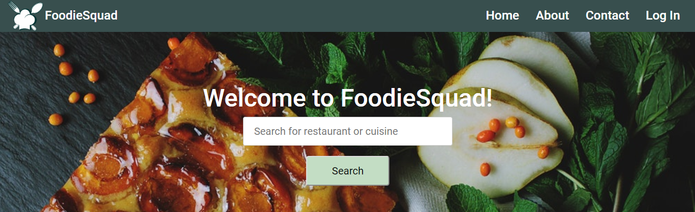
HomePage
User gets to see the home page and can search for any restaurant or cuisine.
Clicking on Search will redirect to restList view which populates the restaurants.

Slide 3
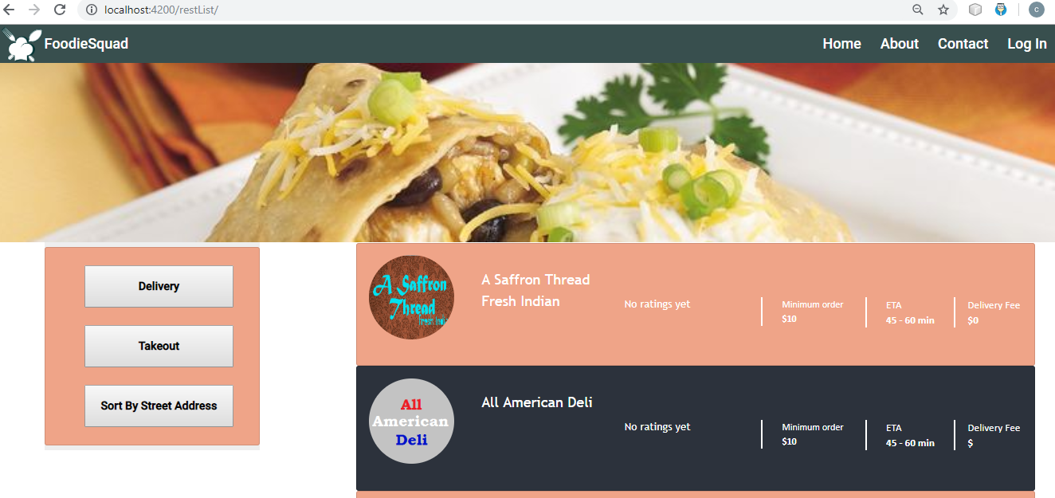
Restaurant Page
Clicking on search provides - restaurant list page in which user can see list of restaurants, minimum amount in which order can be placed, estimated time of arrival of food and delivery fee.
User can also apply filter based on delivery, takeout and street address.

Slide 4
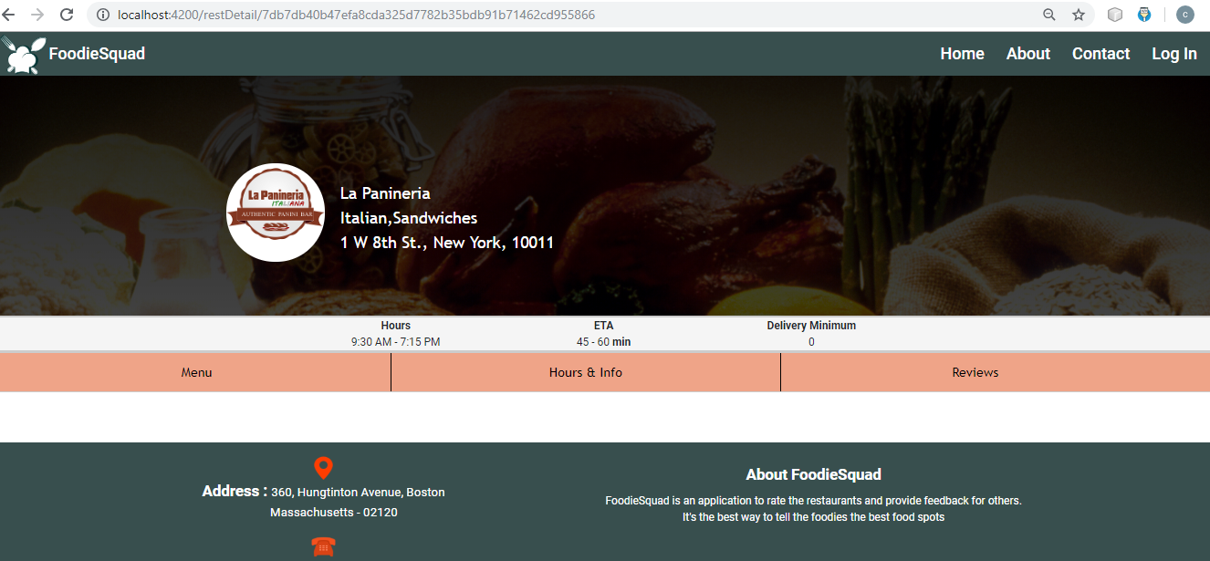
Restaurant Menu Page
Clicking on a particular restaurant provides restaurant menu page in which user can see details of restaurant such as address, types of food, operating hours, menu and reviews.

Slide 5
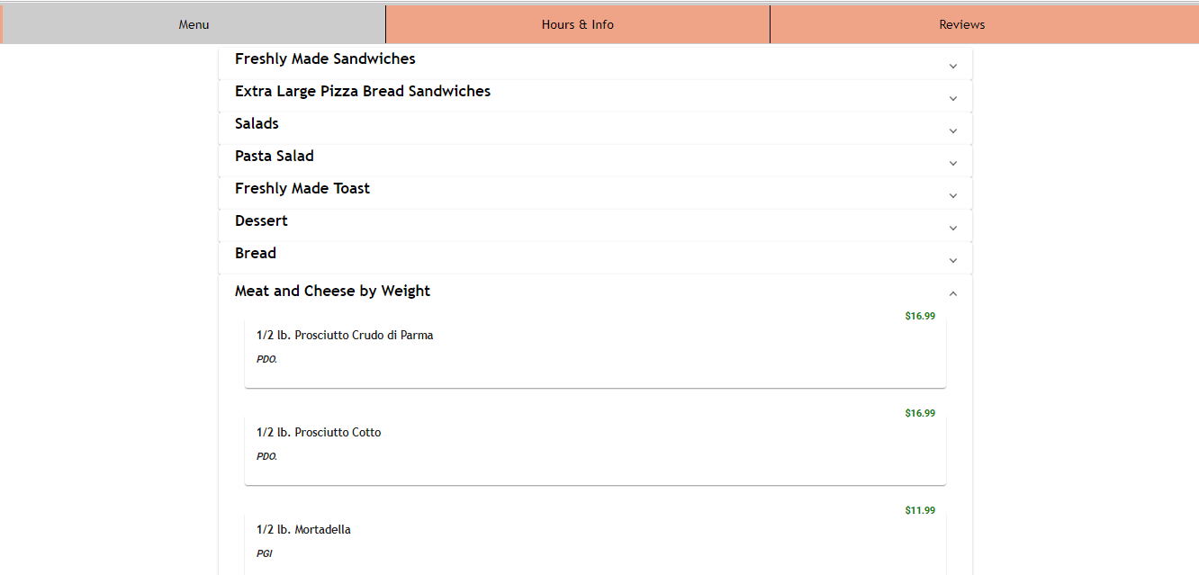
Menu Items
Clicking on menu tab provides information about list of menu and menu items, menu description and its price

Slide 6
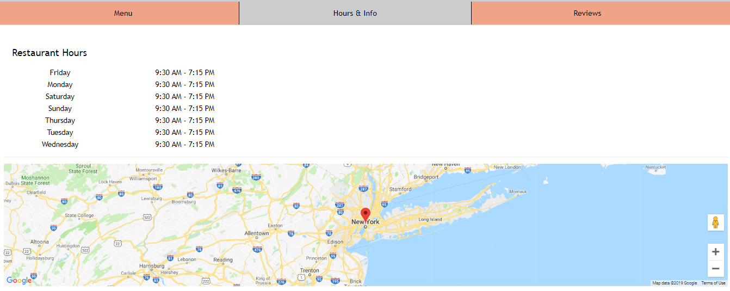
Hours & Info
Clicking on hours and info provides operating hours of the restaurant and its location in google maps

Slide 7
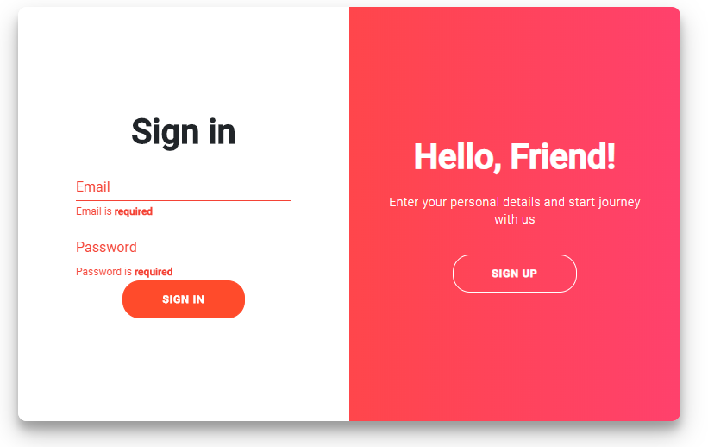
Login Page
Sign in Page has validation for Email as well as as Password if incorrect.

Slide 8
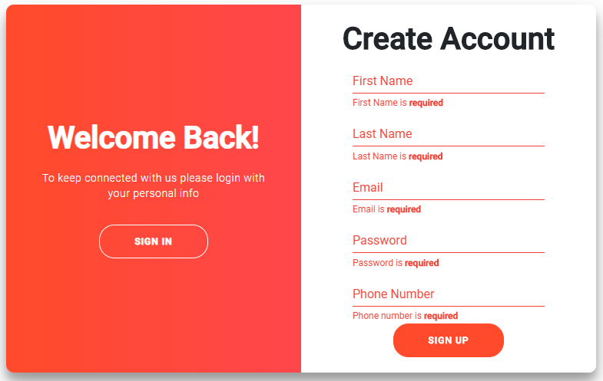
Sign Up Page
Create Account has validations for above fields and creates an account on the Mongo DB database.

Slide 9
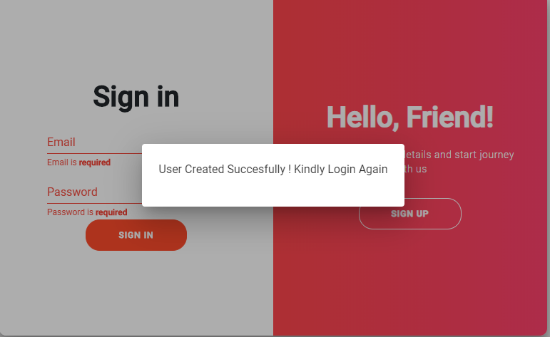
Sign Up Successful

Slide 10
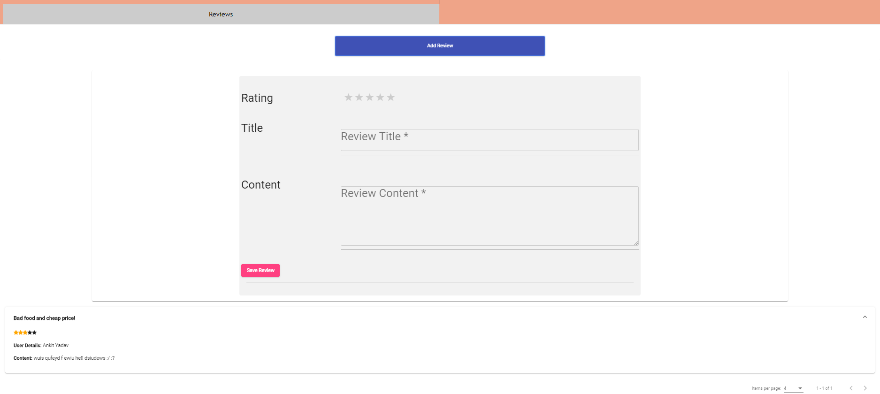
Review
Also User can add review by giving rating as stars and writing review body

Slide 11
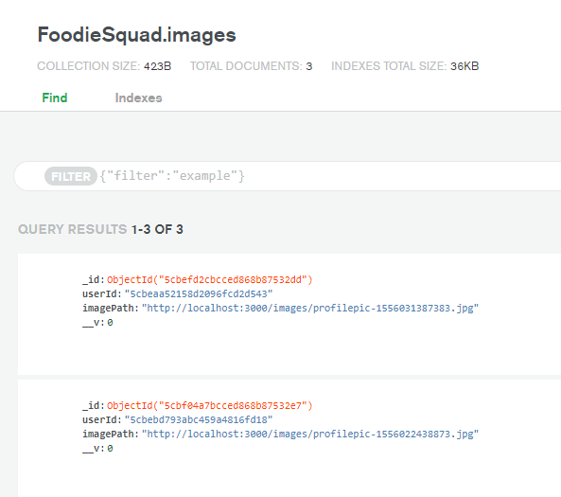
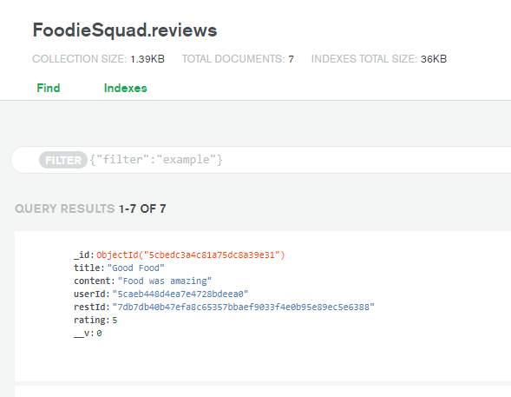
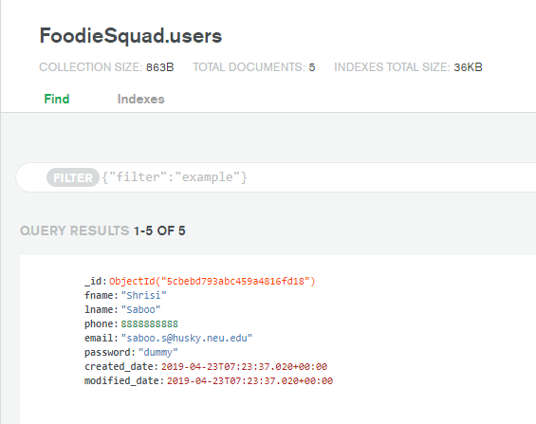
Collections

Slide 12
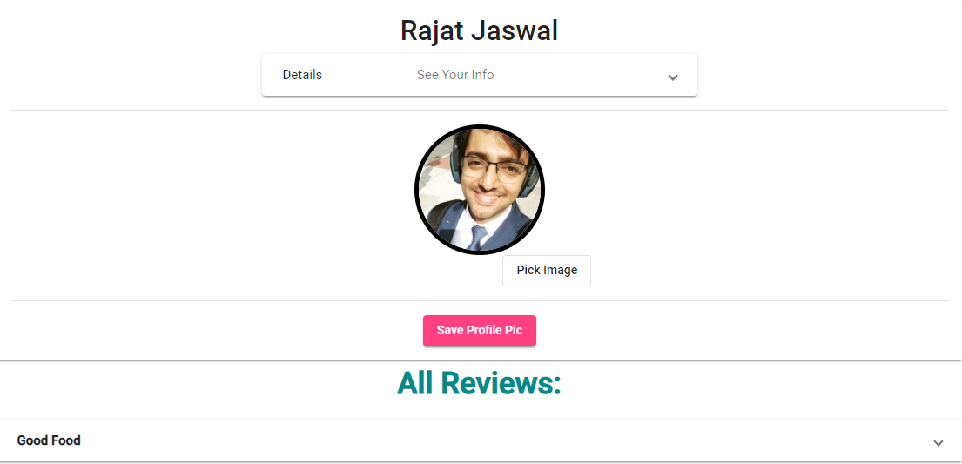
User Home Page

Slide 13
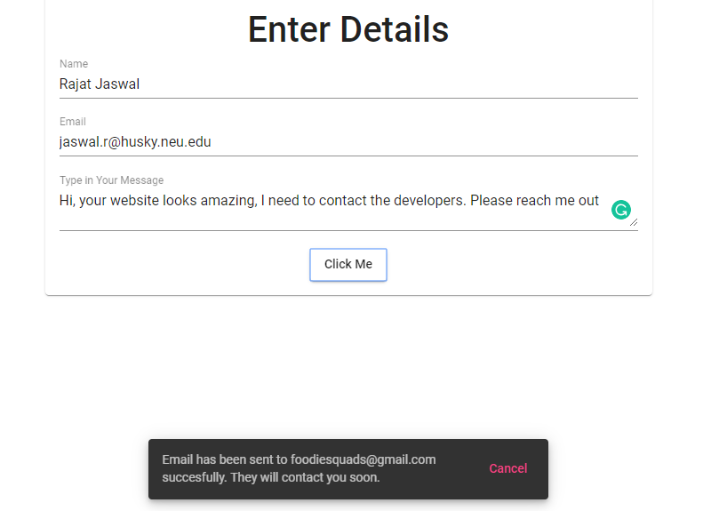
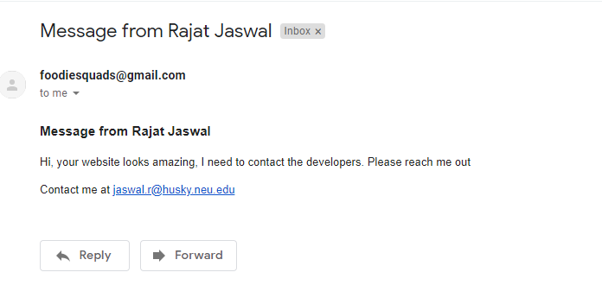
Contact Us Page

Slide 14
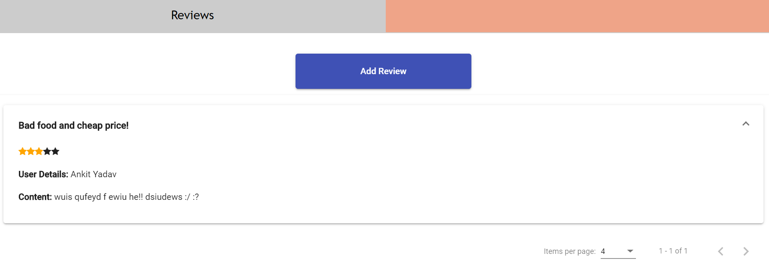
Review
Users view review of restaurants

Slide 15
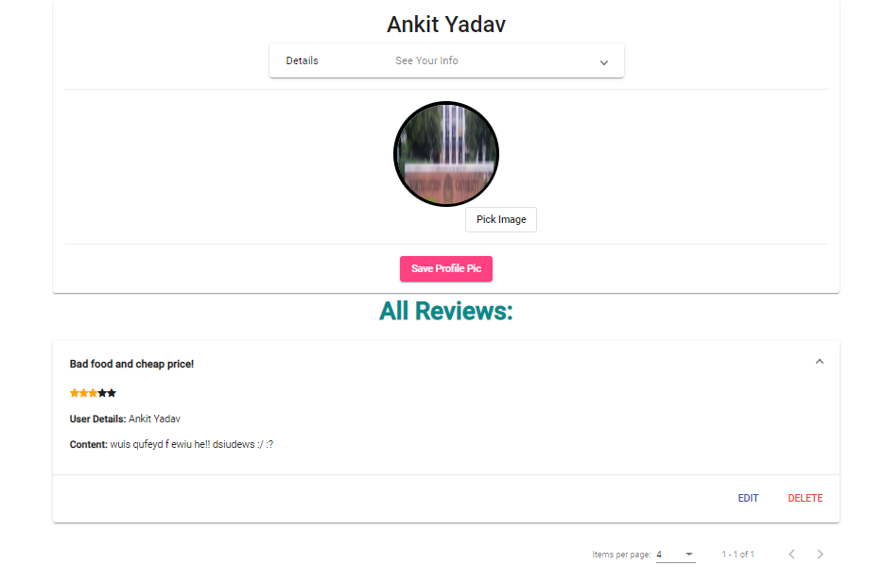
Review
To delete or edit review User need to do the same from user account page

Slide 16
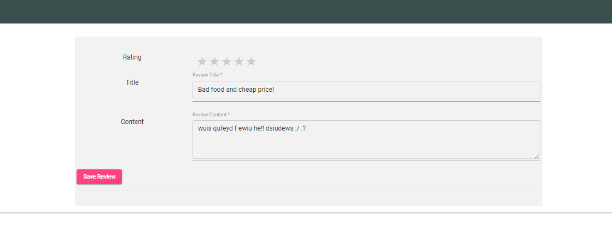
Review
On clicking delete review will be deleted. On clicking edit the user will be taken to edit screen.

